Slide 1
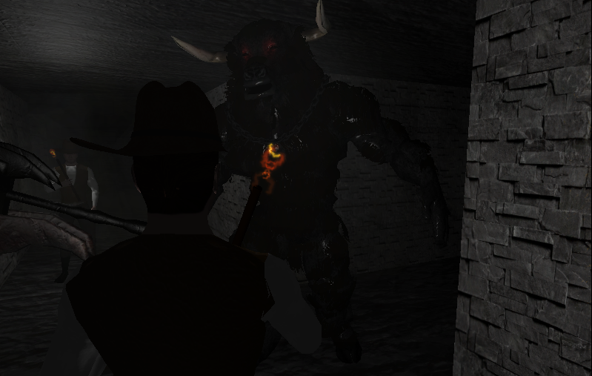
Maze Chase
Marcos Vázquez Rey ESAT 2017

Slide 2


Contents
Sound integration
Procedural maze

Slide 3
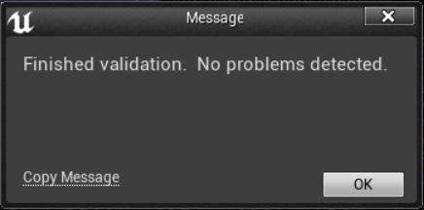
Sound integration
Install FMOD Studio
Download FMOD UE4 plugin
Versions MUST be the same!!
Help → Validate FMOD

Slide 4
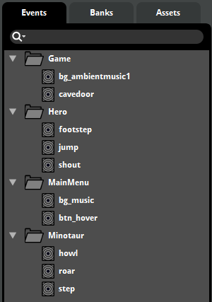
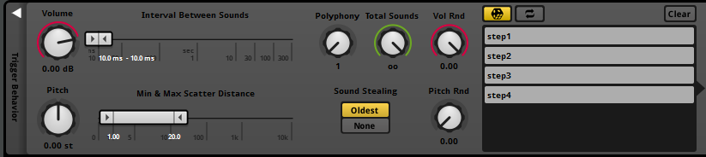
Sound integration
Organize events syntactically
Use scattered sounds for variety

Slide 5
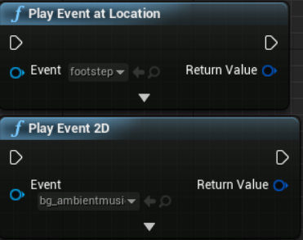
Sound integration
#include FMODBlueprintStatics.h
FMOD events set as variables in editor
Sound is better managed in
FMOD studio

Slide 6
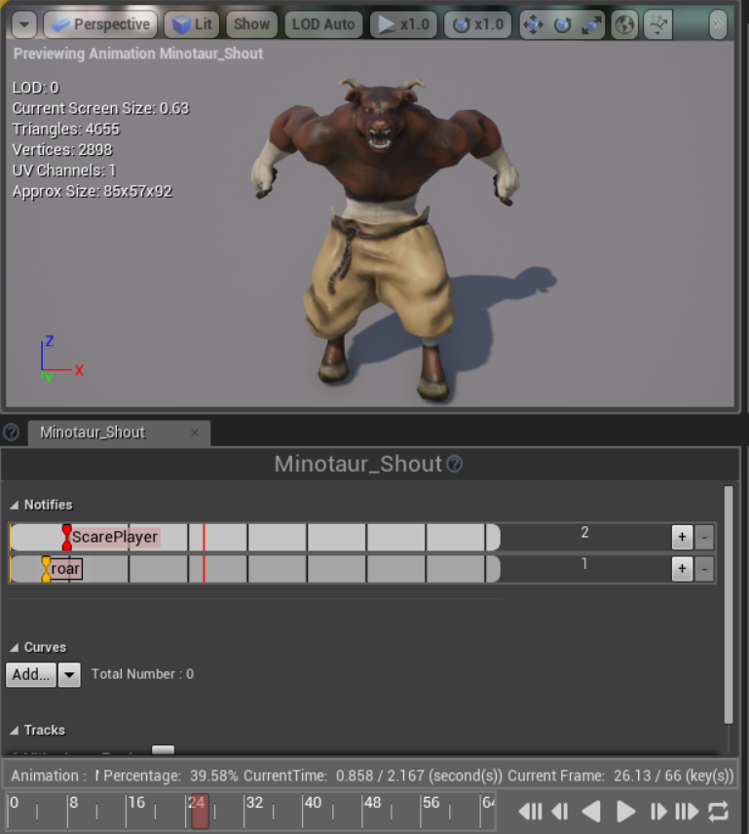
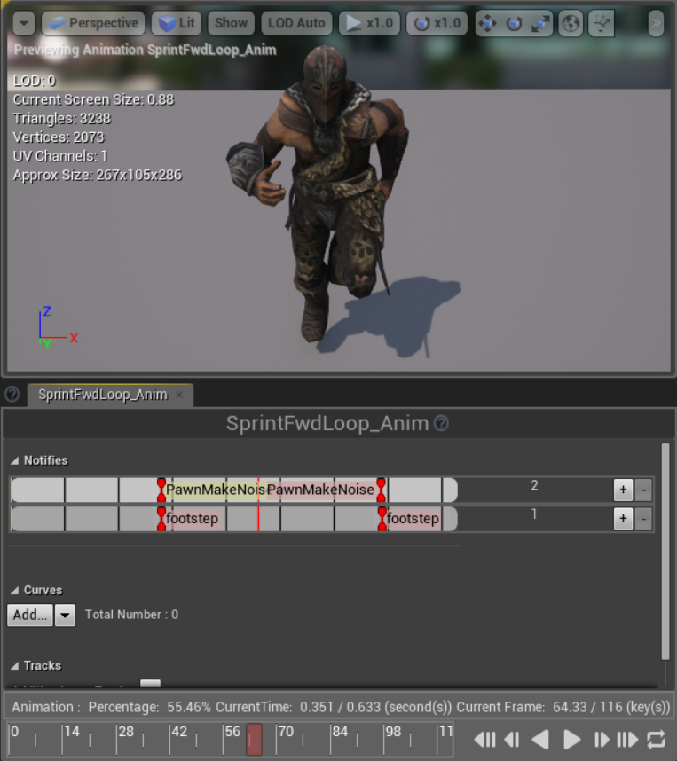
Sound integration
Extensive use of animation notifies

Slide 7
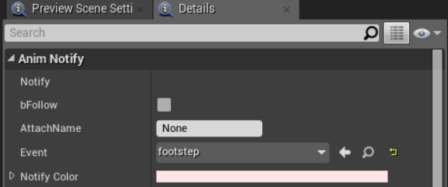
Sound integration
Extensive use of animation notifies

Slide 8
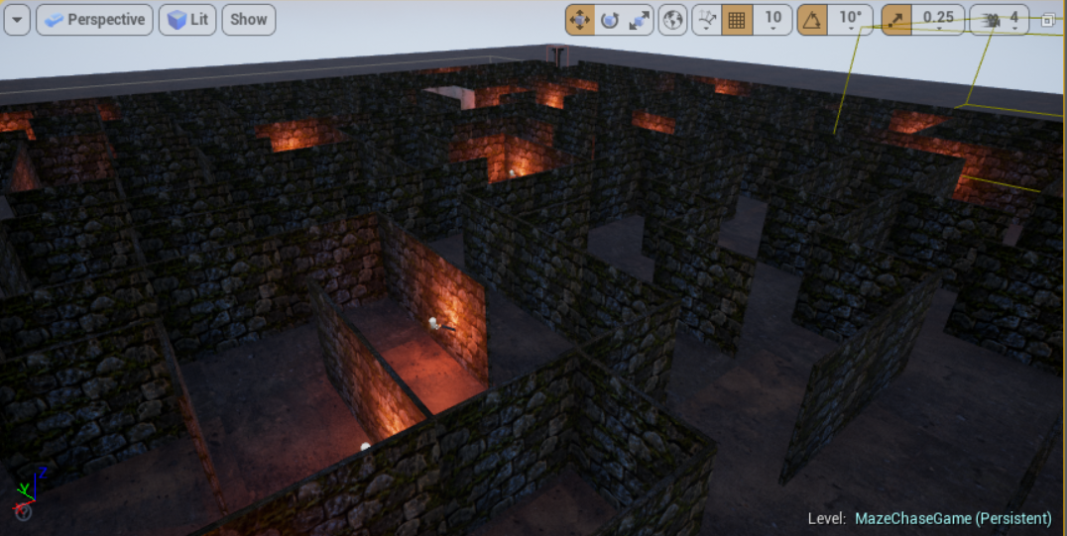
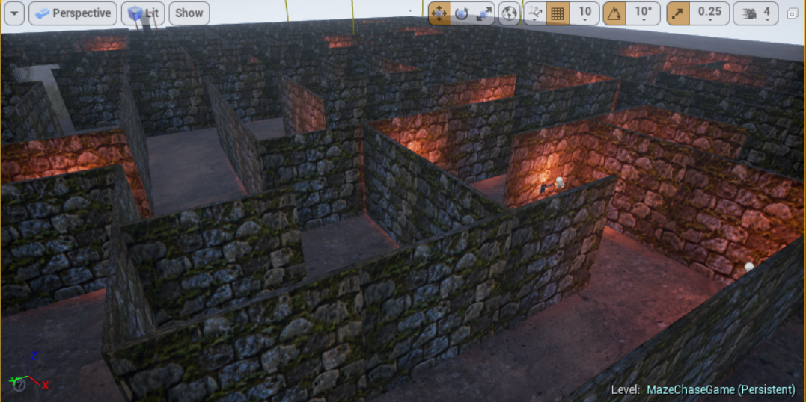
Procedural Maze
Procedural placement of:
Walls
Doors
Torches
Characters

Slide 9
Procedural Maze
Customizable parameters:
Size
Wall separation
Num torches
Num doors

Slide 10
Procedural Maze
Can be used to generate random every time the map loads.
Can be used to pre-generate a maze.

Slide 11
Procedural Maze
Steps:
- Generate maze model
- Raise all walls
- Carve walls according to model
- Place elements (e.g. torches) according to model

Slide 12
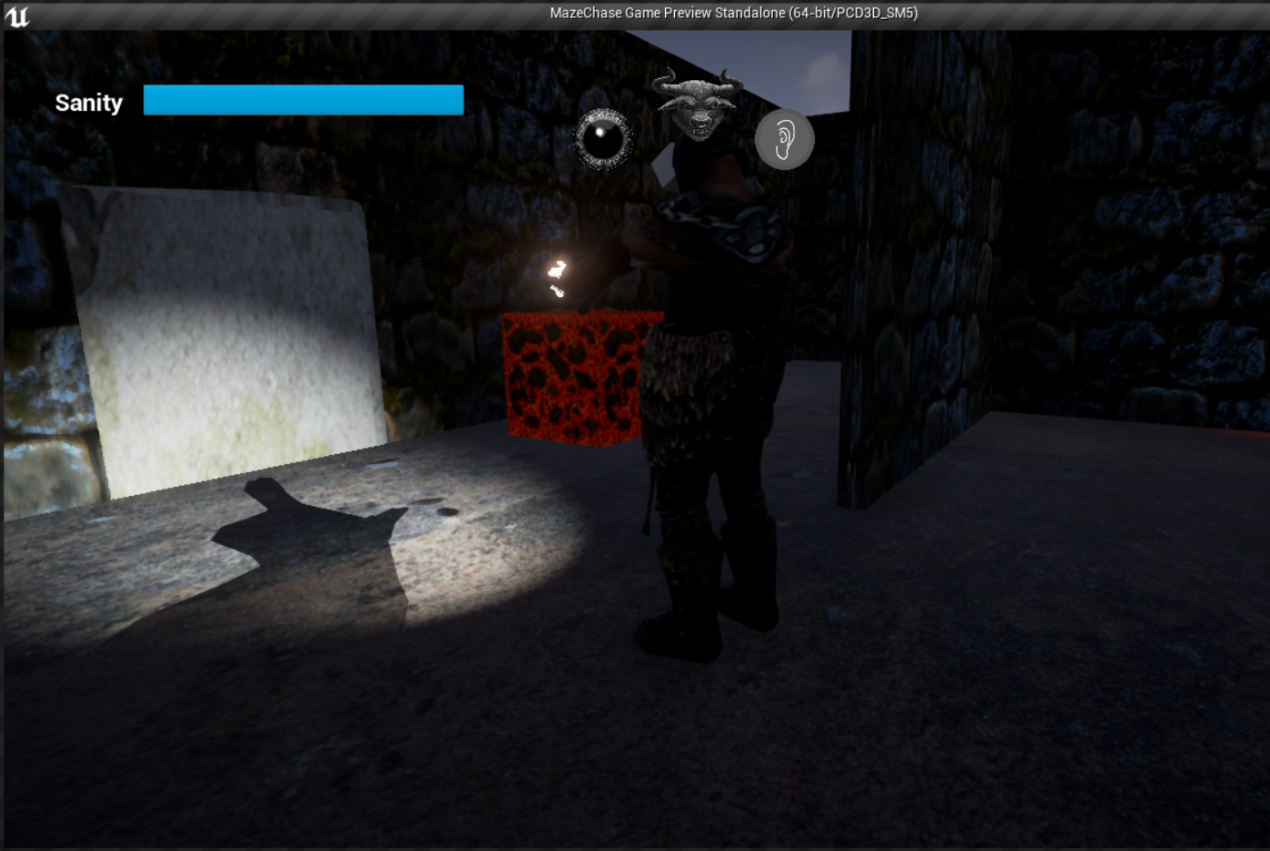
Procedural Maze
Door buttons are placed strictly manually.

Slide 13


